Slide 1
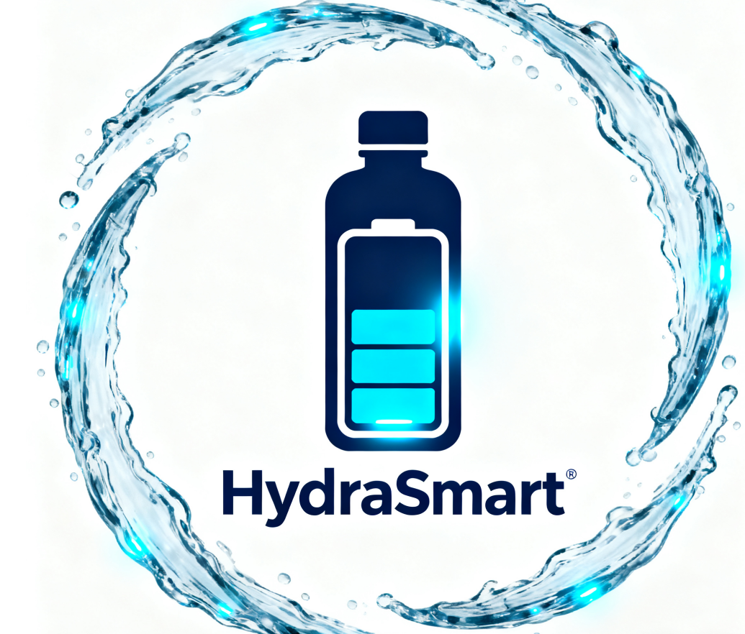
HydraSmart
By Peter, Michael, and James
5

Slide 2

01
Company & Team Intro
05 How can we make money?
02
Customer Problem & Product Intro
06
Money Needed & Usage
03
Hydra Smart: The Product
07
Why Invest in Us?
04
Market & Competitors
08
Summary & Thank You

Slide 3

Company & Team Intro
01

Slide 4

Company & Team Intro
"I am Peter – 5 years in consumer electronics marketing. I have promoted 3 smart hardware products and know how to reach customers."

Slide 5

Company & Team Intro
"I am Michael – electronic engineer with 3 years in smart device R&D. I will lead Hydra Smart’s tech development."

Slide 6

Company & Team Intro
"I am James – 4 years in operations. I will manage supply chains and costs to keep things running smoothly."

Slide 7

Customer Problem & Product Intro
02

Slide 8

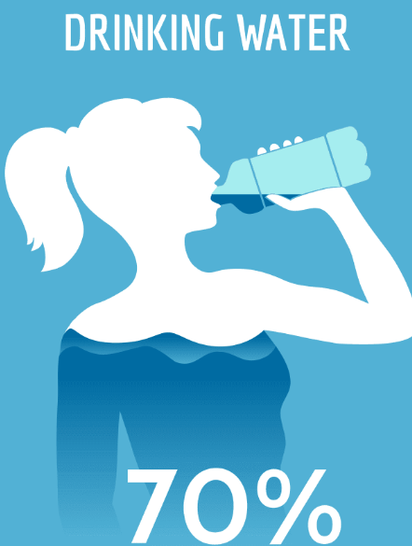
The Problem
People often forget to drink water (busy work/study) or guess how much to drink (after exercise). Long-term poor hydration causes low energy or bad focus.

Slide 9
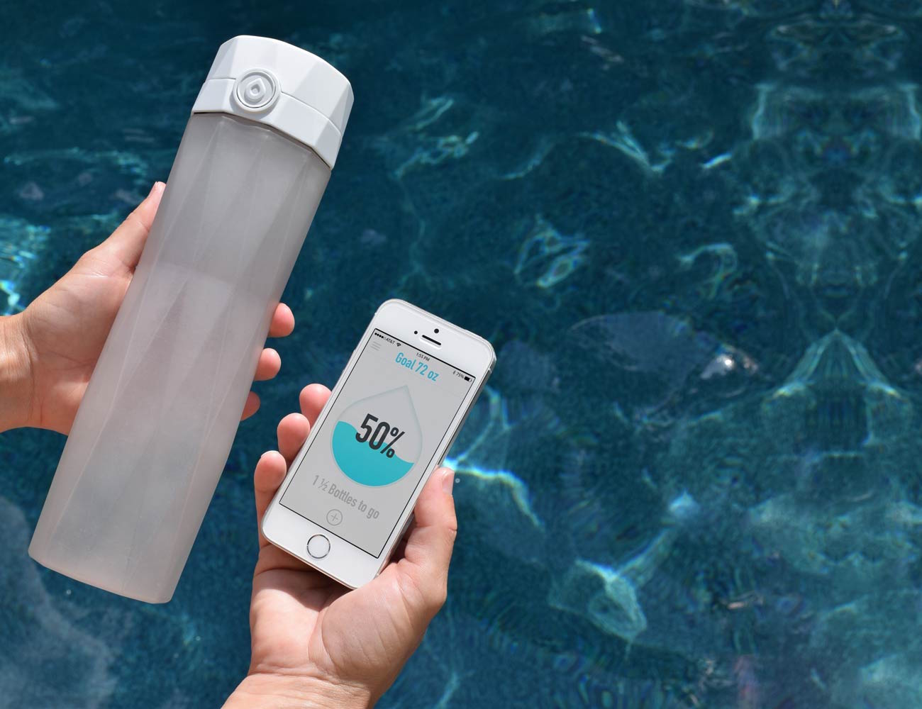
Product Category
HydraSmart is a smart health water bottle (not just a regular bottle) – it solves "unscientific drinking" issues.

Slide 10

"Unscientific drinking" issues mean bad water - drinking habits. Like not drinking water regularly, maybe forgetting to drink or drinking too much at once. Also, not drinking the right amount based on how your body feels or what you're doing. The HydraSmart bottle helps fix these by making drinking water more scientific.

Slide 11
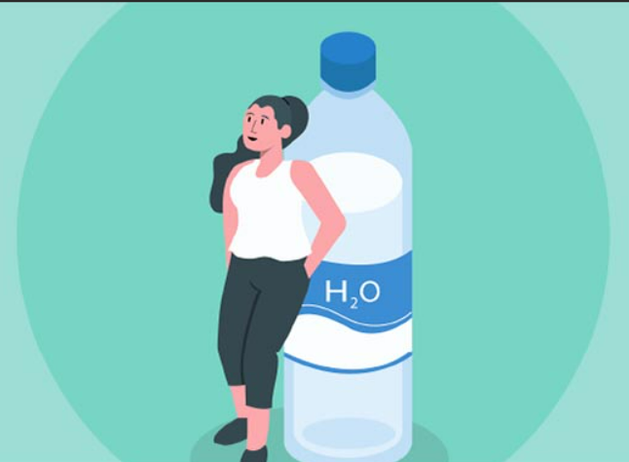
Why is it a Big Problem?
Over 60% of people do not drink enough water (per a health report), and 72% would pay for a solution to fix this.

Slide 12
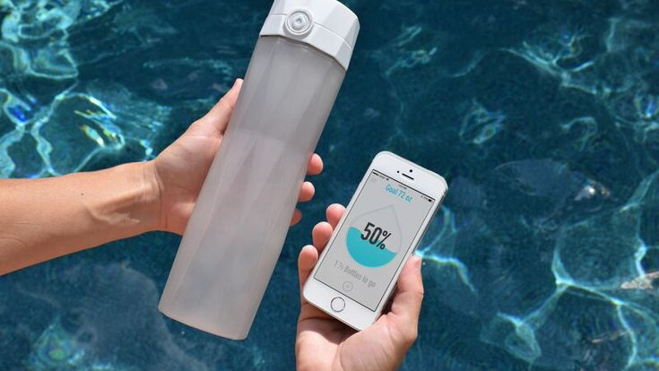
What is it?
"HydraSmart is a smart bottle that tracks your water intake and sends reminders. It also makes a personal drinking plan for you."

Slide 13
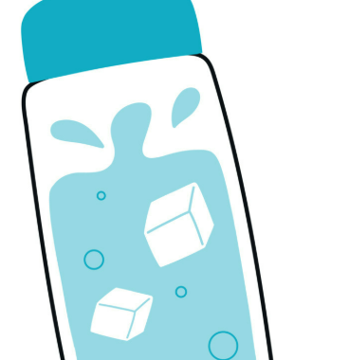
Target Customers
AGE---25-45 years old
GENDER---Male & Female (slight female majority)
INCOME---¥20,000-¥60,000 per month
PAIN POINT---Fast - paced Shenzhen work (meetings, projects)-
forget to drink - dehydration, afternoon fatigue
MARKET---~400,000 people
EDUCATION ---Mainly bachelor's degree or above

Slide 14
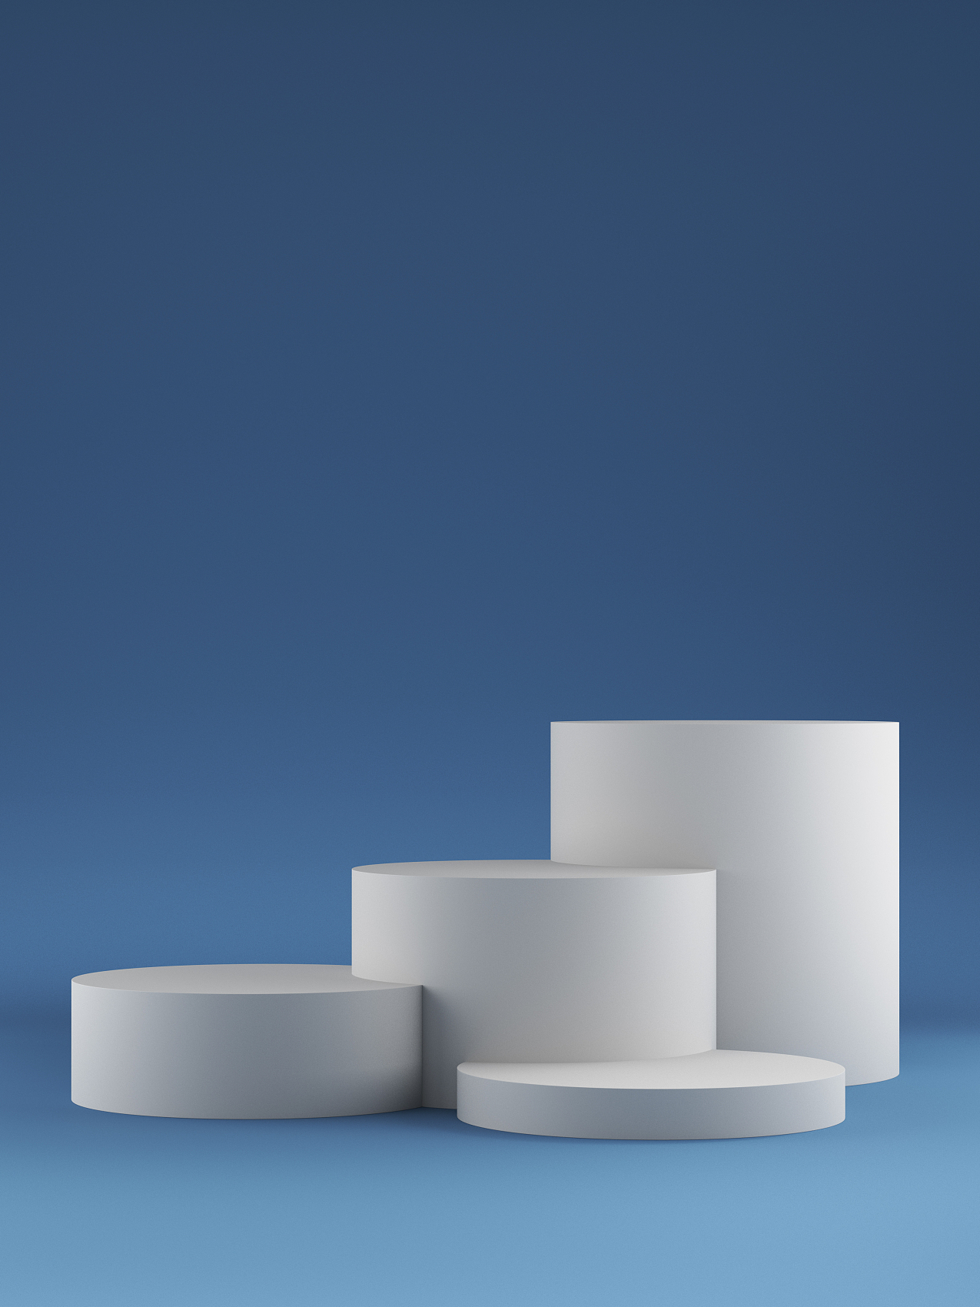
Hydra Smart: The Product
03

Slide 15

How It Stands Out?
Adjusts plans based on your activity (e.g., more reminders after gym).
Checks water quality (TDS level) – tells you if water is clean.

Slide 16

Market & Competitors
04

Slide 17
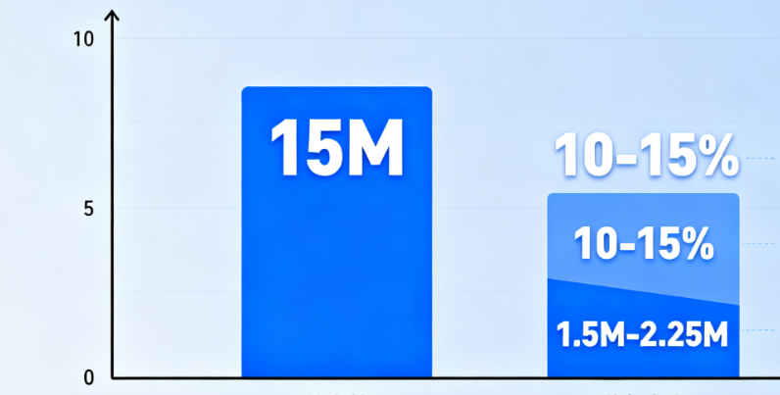



Market Size
Reference: Toubao Research Institute. 2025 China Smart Water Cup Market Research Report. Toubao Research Institute, 2025, https://m.book118.com/html/2025/0408/5014302113012131.shtm.
Market Size (1st Year)
Total target: 25-40-year-olds in city Shenzhen – ~15M people.
10-15% might buy it: ~1.5M-2.25M customers in Year 1.

Slide 18
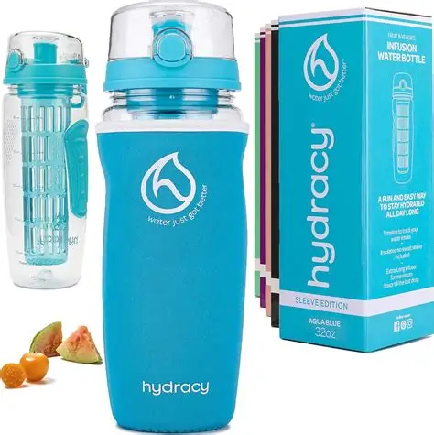
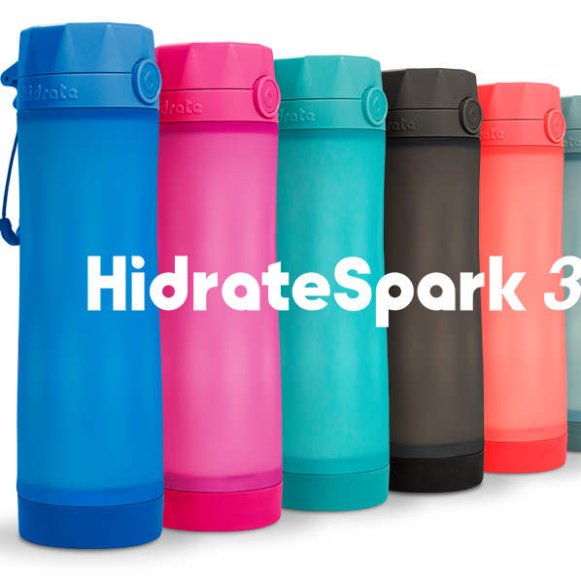
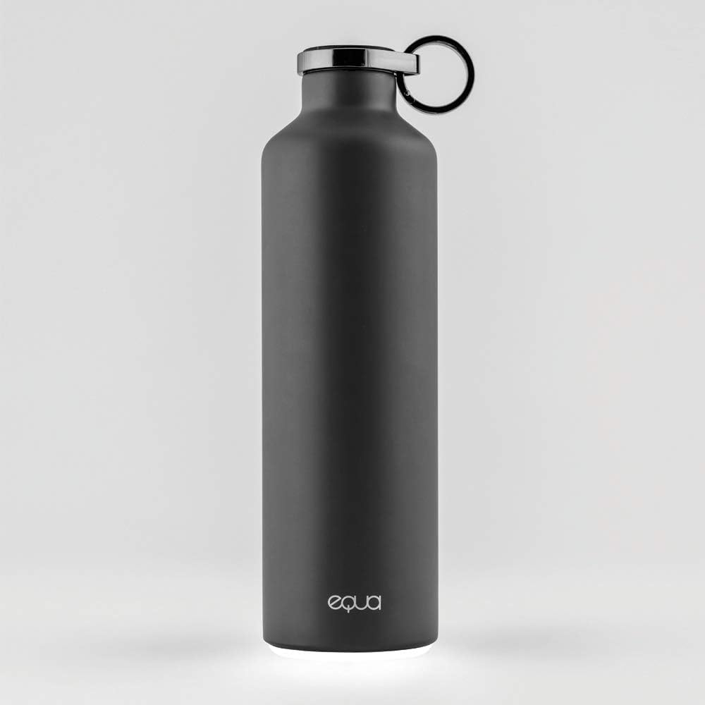
Competitor Grid
Hydracy
HidrateSpark
Equa
Smart bottle with timing reminders
Tracks water intake via app
Eco-friendly smart bottle with hydration tracking

Slide 19

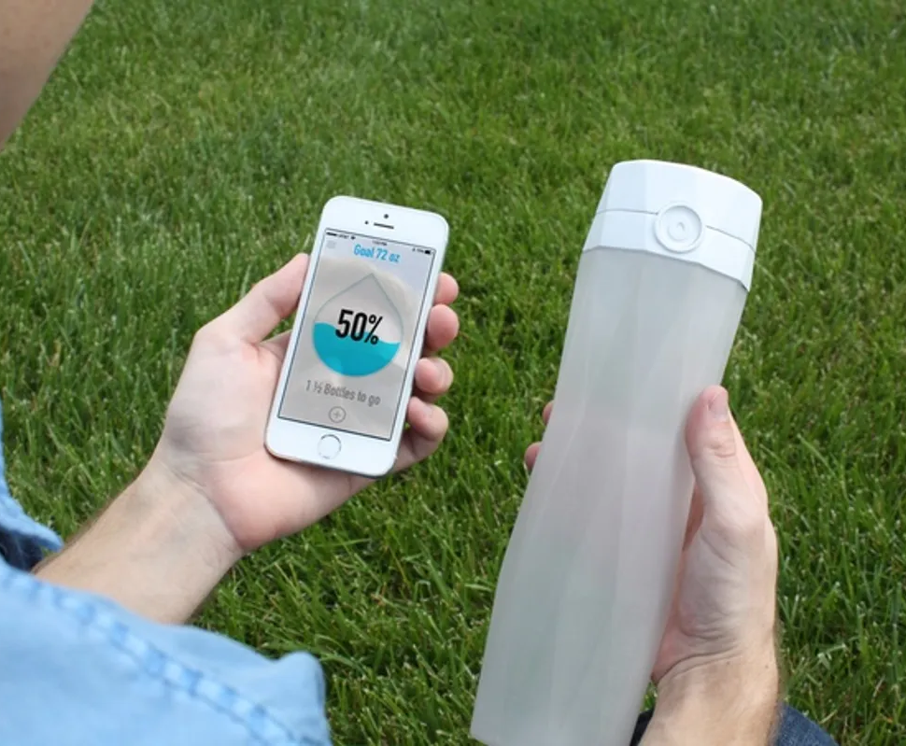
Competitor Grid
HydraSmart outperforms competitors with its AI - driven, hyper - personalized hydration app, durable yet lightweight patented material, and advanced real - time tracking and customization, all while being leak - proof and ergonomically designed.

Slide 20

How Can We Make Money?
05

Slide 21
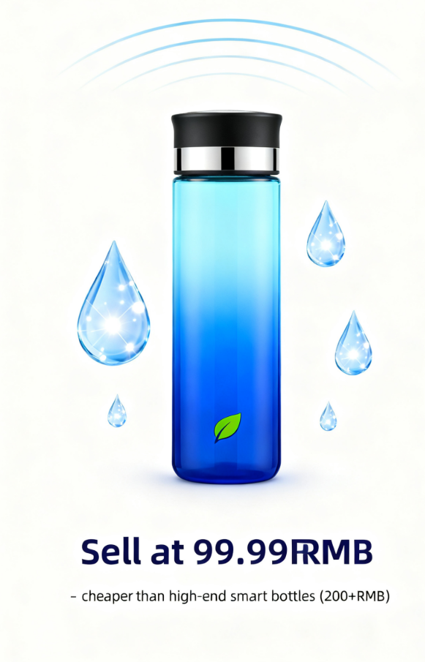
How Can We Make Money?
Price
Sell at 99.99RMB – cheaper than high-end smart bottles (200+RMB) and affordable for our target customers(people who care about their health and want to stay hydrated. They also like using cool, tech - based products in their daily lives).

Slide 22

How Can We Make Money?
Costs
Per unit cost: ~60RMB (materials: 25RMB, production: 20RMB, shipping: 15RMB).
Reference：FasterCapital. (n.d.). Cost per Unit: Breaking Down the Cost per Unit in Equivalent Production. Retrieved from https://www.fastercapital.com/content/Cost-per-Unit--Breaking-Down-the-Cost-per-Unit-in-Equivalent-Production.html

Slide 23

How Can We Make Money?
Year 1: 1.5M customers × 99.99 RMB = ~150M RMB revenue. Minus costs (say 60M RMB) → ~90M RMB profit. Selling at 99.99 RMB is cheaper than high - end smart bottles (over 200 RMB) and affordable for our target customers(people who care about their health and want to stay hydrated. They also like using cool, tech - based products in their daily lives).
Reference：Journalia Blog. (n.d.). Unit Product Cost: Key Metric For Manufacturing Efficiency. Retrieved from https://journalia.blog/unit-product-cost-manufacturing-efficiency-metric/
Profit (Estimate)

Slide 24
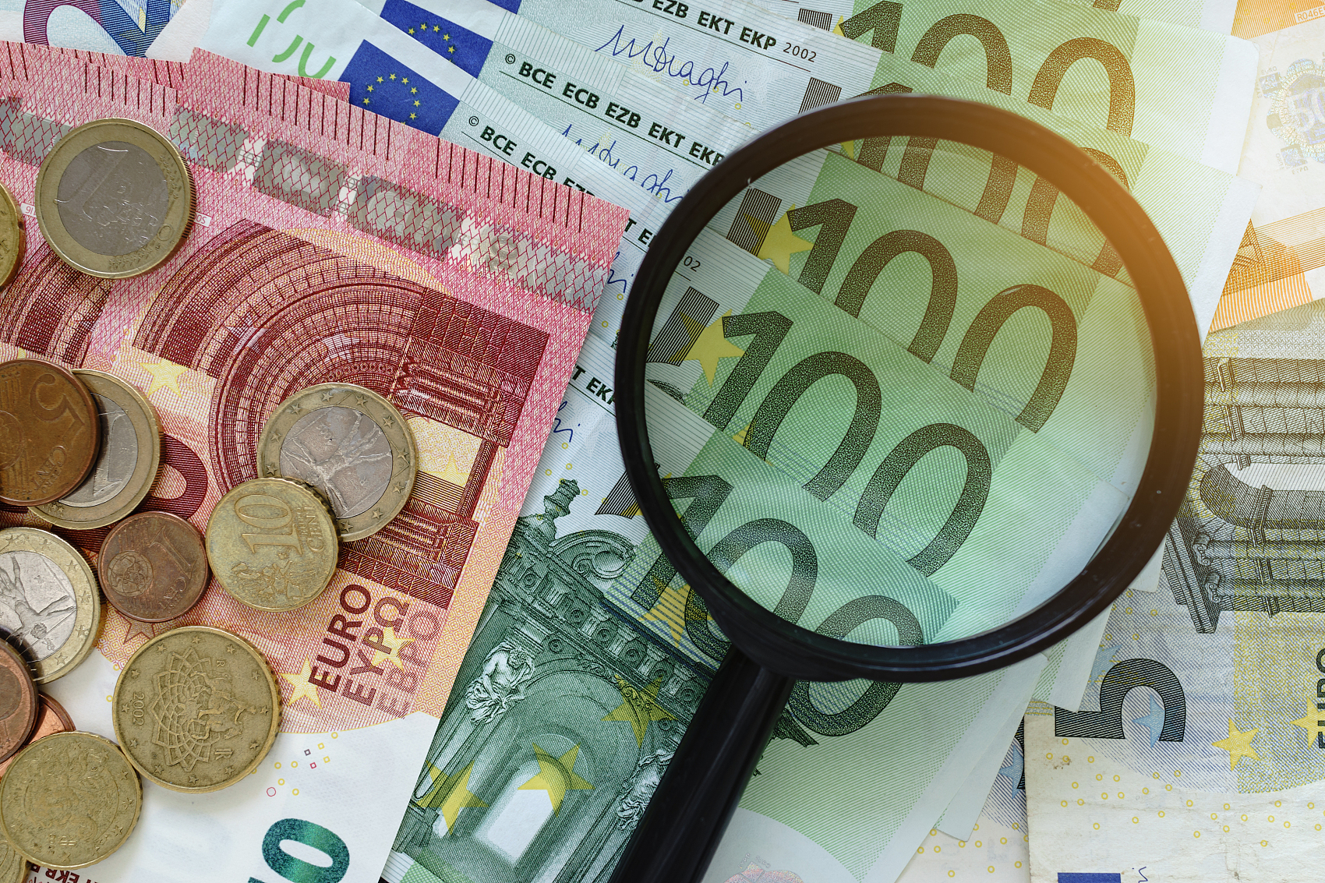
Money Needed & Usage
06

Slide 25
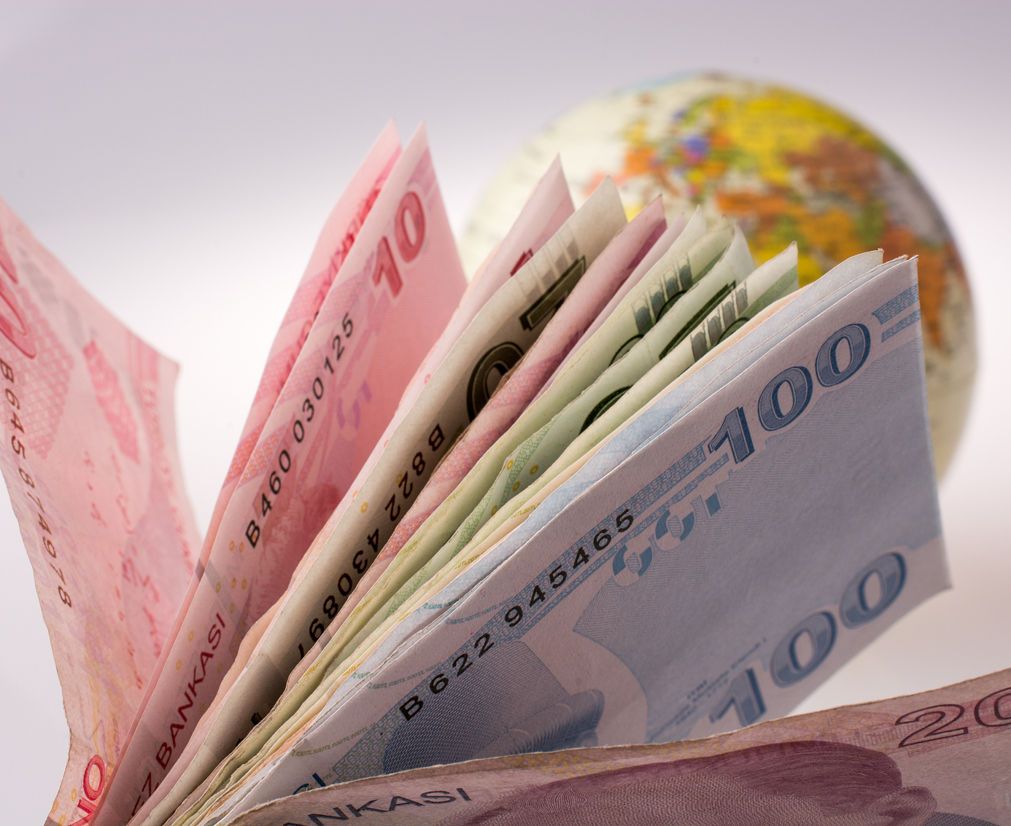
Money Needed & Usage
Ask: "2M RMB investment."
To cover machine costs for our venture, we need around 2 million RMB. This includes buying key equipment, setting it up, training staff to use it, and covering ongoing maintenance.

Slide 26

Money Needed & Usage
01
50%: Finish product development.
02
30%: Marketing (ads, social media).
03
20%: Operations (supply chain, team).
Reference: TechStart Co. (2025). Investor deck: Money needed & usage. Retrieved from https://techstartco.com/deck

Slide 27
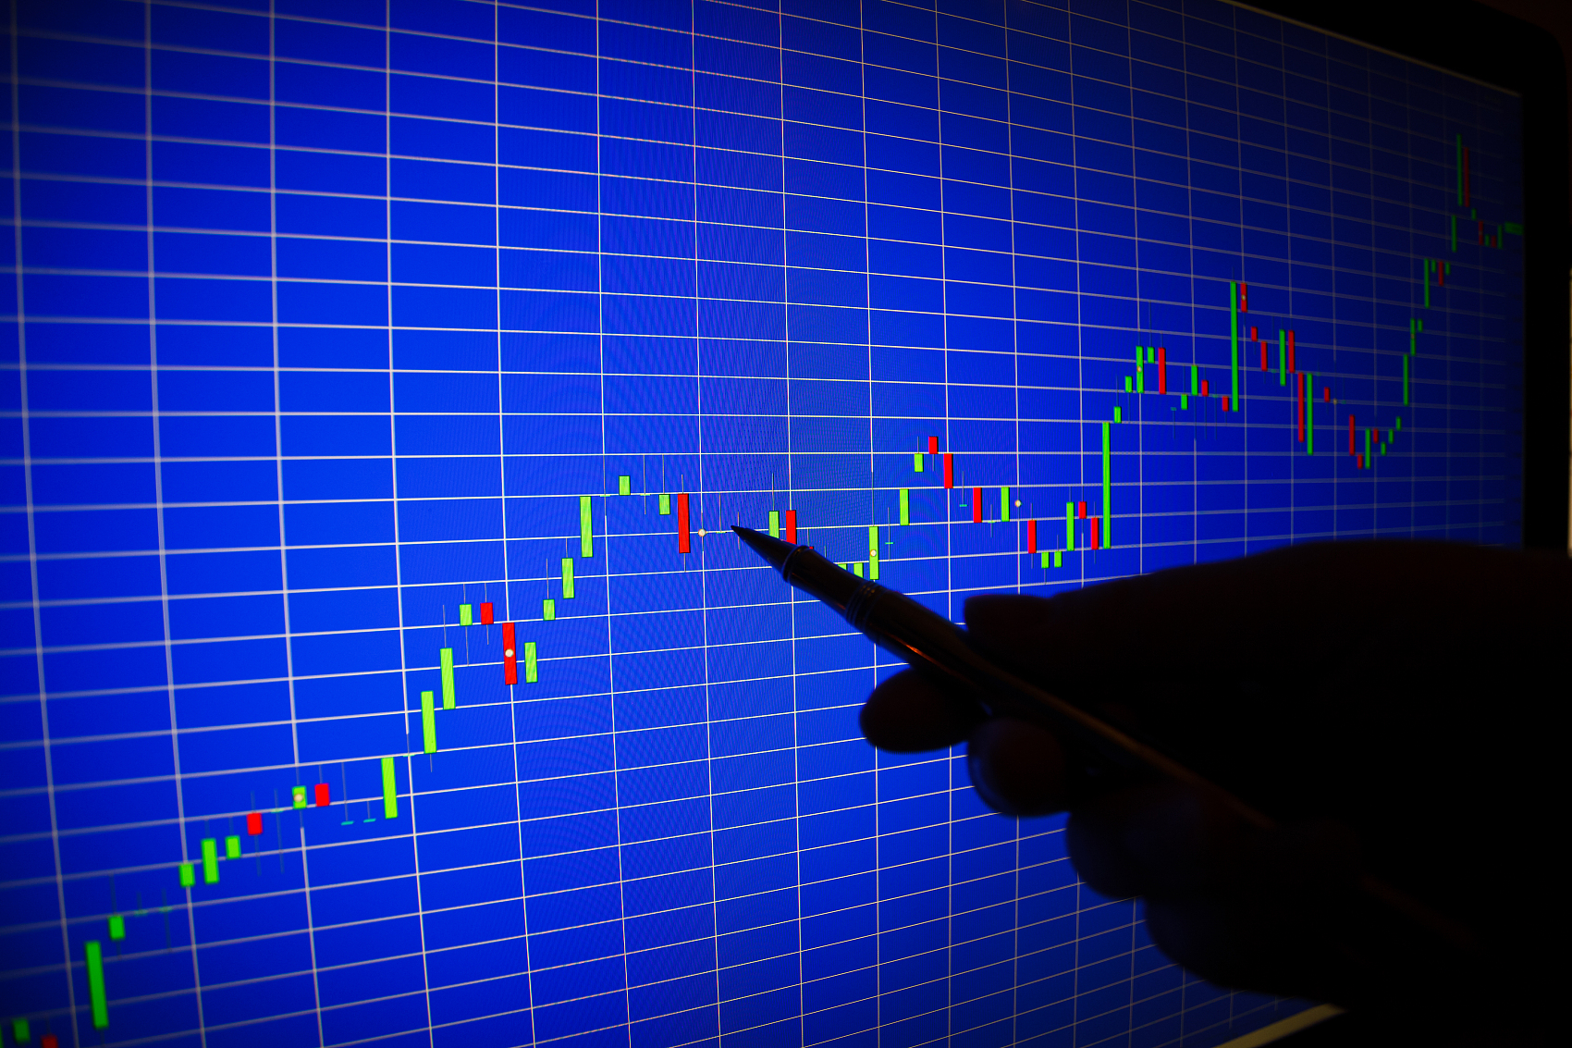
Why Invest in Us?
07

Slide 28

Why Invest in Us?
Big problem (60% need better hydration).
Good product (unique features, low price).
Strong team (Peter=marketing, Michael=tech, James=ops).

Slide 29

Summary & Thank You
08

Slide 30

Summary
Peter, Michael, and James present the HydraSmart smart water bottle—solving poor drinking habits with intake tracking, reminders, and personalized plans—targeting Shenzhen’s 25-45-year-old professionals. It has a ¥99.99 price (cheaper than high-end options), projects ~¥90M Year 1 profit, seeks ¥2M investment (for product dev, marketing, operations), and argues it’s a good investment due to big market needs, strong features, and a capable team.

Slide 31

Thank you!

